Slide 1
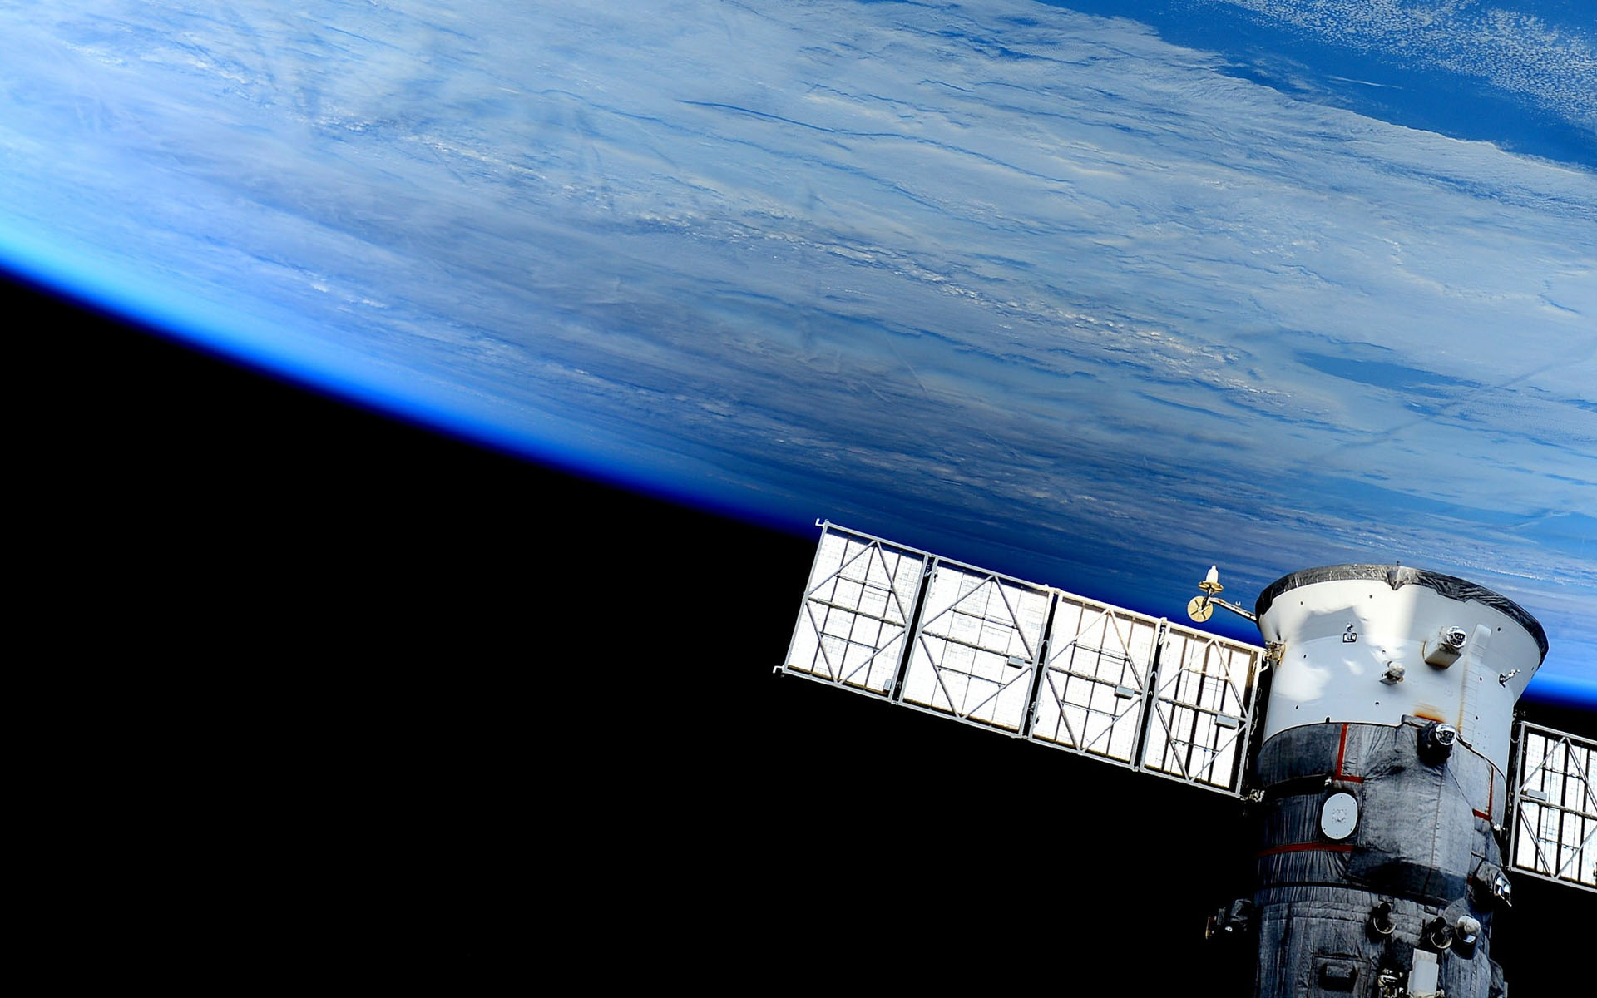

Batteries Tester
Blanca Cano Camarero
Javier Germán Luzón Hidalgo
Miguel Romero García

Slide 2
Index
Last week summary
Collaborative work
Progress videos
Interface building and use
Remete controle

Slide 3
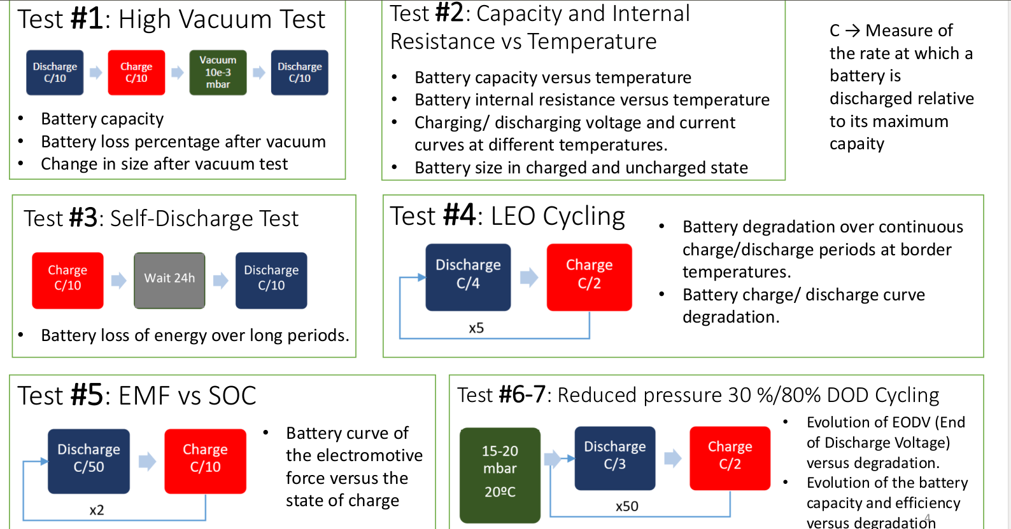
BATTERY TESTS

Slide 4
Collaborative works
ACHIEVE UNIFICATION
HARDWARE TEAM
Miguel and Javier
Objetives
  Machine control
  Machine measurements
  Security controls
Problems
  Code and communications
Achievements
  First test: EMF VS SOC
SOFTWARE TEAM
Blanca
Objetives
  Web server
  Interface app.
  Data managements
  Remote controle
Problems
  Raspberry power.
  Wifi connection
Achievements
  Interface
  Data management

Slide 5
SUPPLY LOAD MULTIMETER

Slide 7
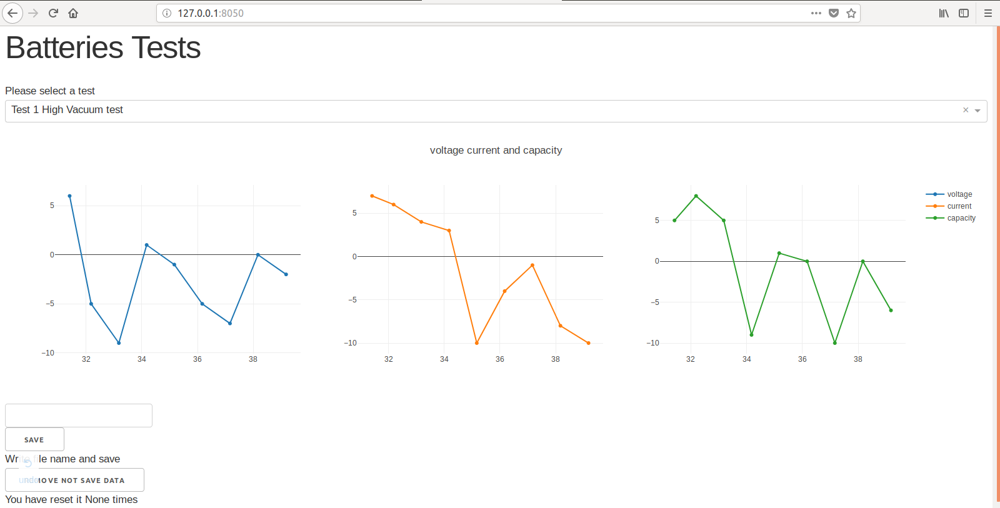
First functional interface
We have finished web page server.
Let have a direct prove:
Host and port direction
Dropdown to select test data
Change display data
Inbox to introduce data file name
Zoom in /zoom out.
Move inside
Download plot as png
Remove recollect data

Slide 8
Interface and web application
Problems and solutions
Interface design:
  In development dash library
Data save:
  Problems:Unkonw data size,physical limits, memory.
  Solutions:
    Use danque, special limited python list.
    Hide file .Test.csv managed by shell’s comands in window and linux to save all data.

Slide 9


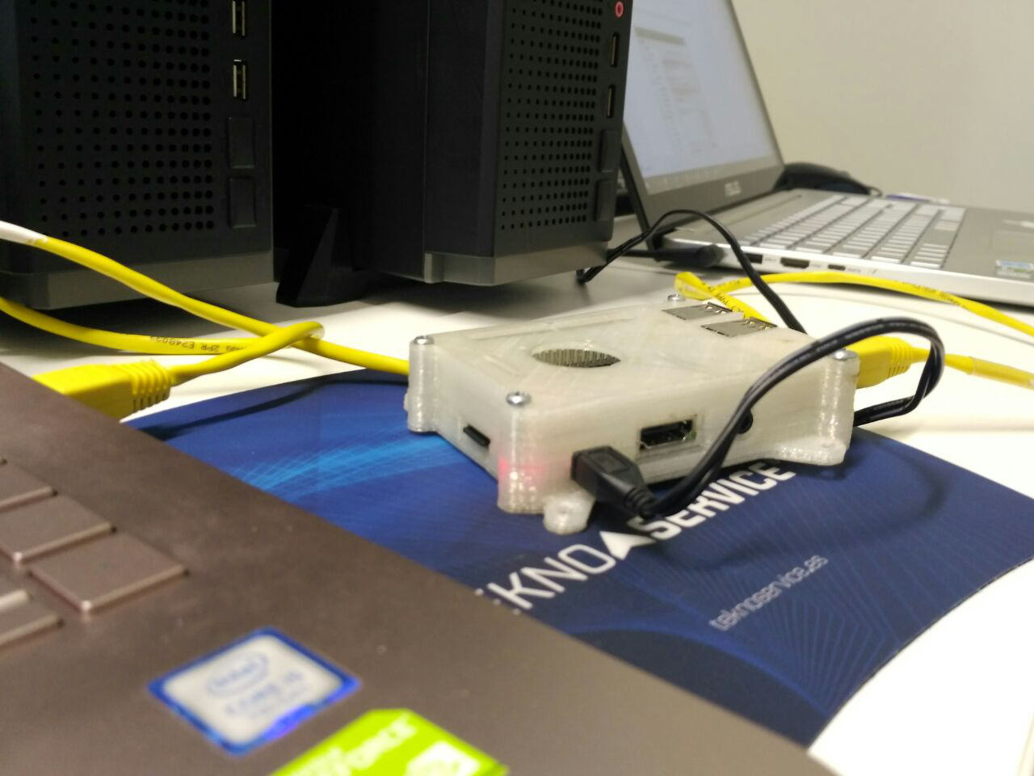
Remote control
vs
First approach: Raspberry pi control
Dietpi in raspberry.
  Lighter:
    ssh control use console
    No CPU graphics use.
Our own server:
  Remote control.
  Problems:
    Linux OS vs vista: privative software.
    CPU use: 95 %
    Wifi connection problems,
Successful Ethernet connection !
Actual approach: Telegram bot
Remote control.
Instanstane information in you movile phone.

Slide 10


Questions round
QUESTIONS ROUND

